Slide 1
Multi-tenant architecture
separate database for each client

Slide 2
Technology & Platform
Platform: Java, Spring Boot, MySQL
Documents: Architecture Diagram, Flow Diagram, Approach Doc

Slide 3
Why/What is multi tenant database
Multi-tenancy means that a single instance of the software and its supporting infrastructure serves multiple clients.
Each client’ss shares the software application with different database.
Advantages:
Multi-tenant database provides is that the application is shared.
Through centralizing resources, all customers are maintained at the same version, reducing the overhead an application provider would otherwise encounter when maintaining multiple versions of an application across deployments.

Slide 4
Points Covered
Flexible UI to demonstrate Multi-Tenant architecture.
Used a default data source and configurable different data sources for each clients.
Tenant-id is used to differentiate data sources/databases.
Example taken: Attendance Portal.
Client 1: GSS Client 2: KITE Client 3: CAS
Assigned separated database for all 3 clients.
When a client tries to login to portal, tenant-id will be identified to find database. Using that database authorization will happen. And their punch entry will be inserted into respective database.

Slide 5
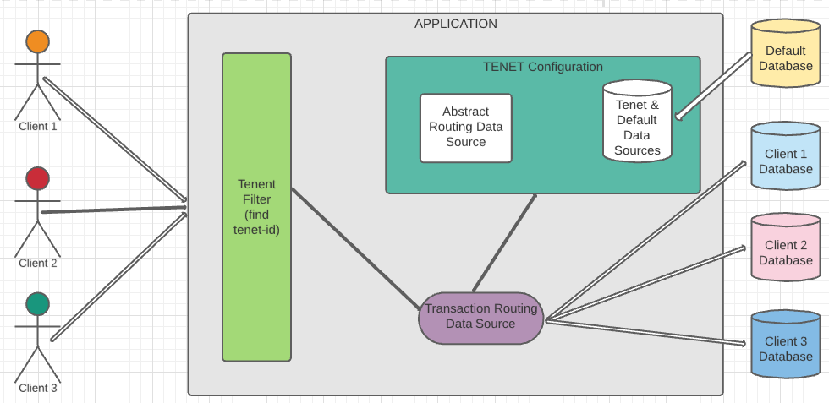
architecture diagram

Slide 6
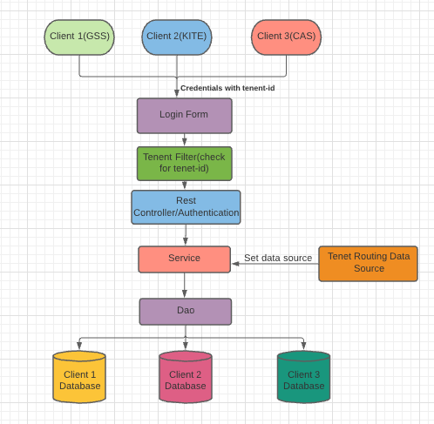
Flow diagram

Slide 7
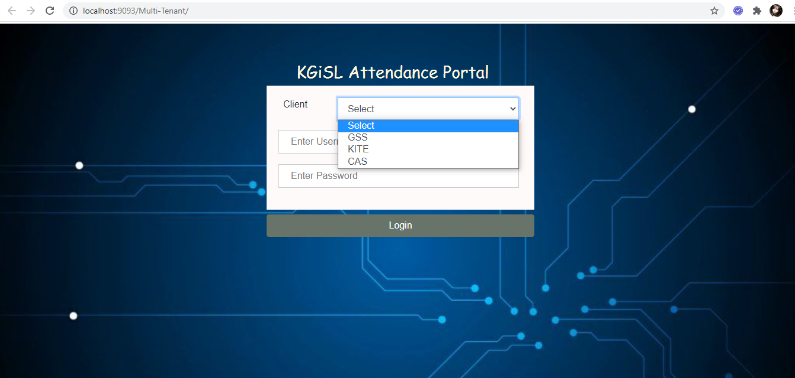
Single application instance for diff clients

Slide 8
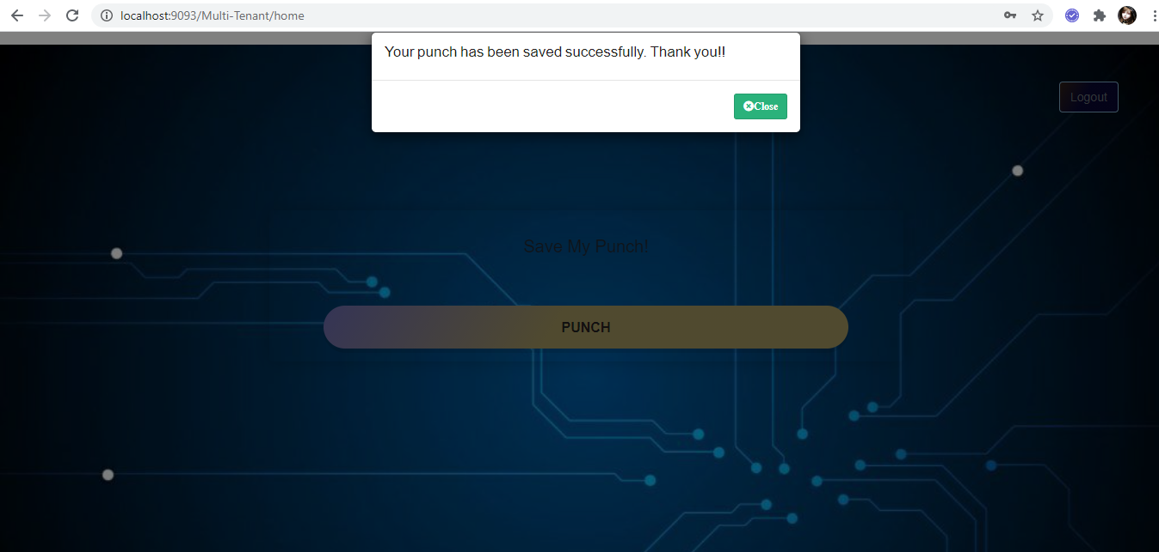
How punch entry entered into related db

